Slide 1

Identity and Access Management

Slide 2

Identity and Access Management ( IAM)
In this module we are going to focus following sections:
Account users and IAM
Organizing users
Federating users
Multiple accounts
Granular Permissions
Support for multi-factor authentication
AWS Identity and Access Management (IAM)

Slide 3
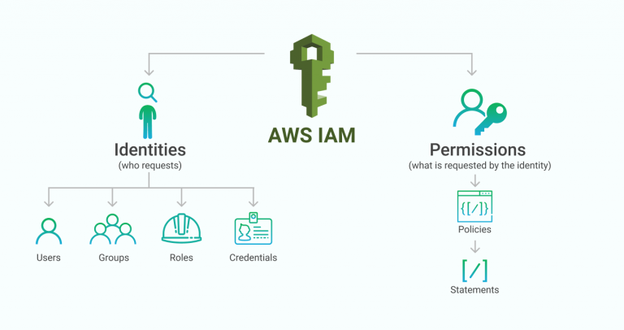
Identity and Access Management ( IAM)
AWS Identity and Access Management (IAM) provides fine-grained access control across all of AWS.
With IAM, you can specify who can access which services and resources, and under which conditions.
With IAM policies, you manage permissions to your workforce and systems to ensure least-privilege permissions.
IAM is an AWS service that is offered at no additional charge

Slide 4









IAM : Root Account
1. Create an IAM admin user
Root user
2. Lock away the root user credentials
3. Start using IAM users
IAM user
AWS Management Console
AWS Command Line Interface (AWS CLI)
AWS Tools and software development kits (SDKs)

Slide 5







IAM Components
Defined in your AWS account. Use credentials to authenticate programmatically or via the AWS Management Console.
IAM user
A collection of IAM users that are granted identical authorization.
Amazon Elastic Compute Cloud (Amazon EC2) instances
Full access
IAM group
Read-only
Amazon Simple Storage Service (Amazon S3) bucket
Defines which resources can be accessed and the level of access to each resource.
IAM user, IAM group, or IAM role
IAM policy
IAM policies
Mechanism to grant temporary access for making AWS service requests. Assumable by a person, application, or service.
IAM role

Slide 6
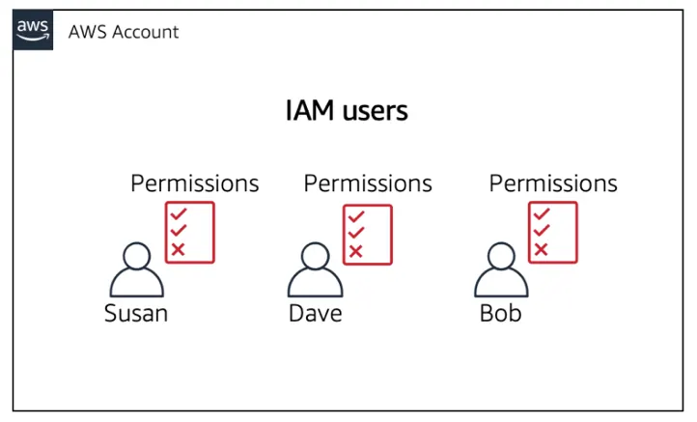
IAM: Users
IAM-user is an entity that you create in AWS to represent the person or application that uses it to interact with AWS. A user in AWS consists of a name and credentials.
An IAM user with administrator permissions is not the same thing as the AWS account root user.
By default, a brand new IAM user has no permissions to do anything.
Each IAM user is associated with one and only one AWS account. Because users are defined within your AWS account, they don't need to have a payment method on file with AWS. Any AWS activity performed by users in your account is billed to your account.

Slide 7
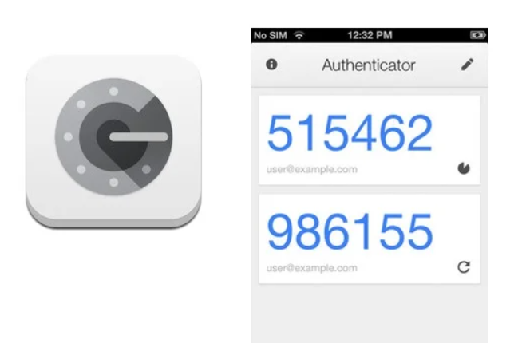


IAM Multi-Factor Authentication
MFA adds extra security because it requires users to provide unique authentication from an AWS supported MFA mechanism in addition to their regular sign-in credentials when they access AWS websites or services:
Virtual MFA devices. A software app that runs on a phone or other device and emulates a physical device. The device generates a six-digit numeric code based upon a time-synchronized one-time password algorithm. The user must type a valid code from the device on a second webpage during sign-in. Each virtual MFA device assigned to a user must be unique.
U2F security key. A device that you plug into a USB port on your computer. U2F is an open authentication standard hosted by the FIDO Alliance. When you enable a U2F security key, you sign in by entering your credentials and then tapping the device instead of manually entering a code
Hardware MFA device. A hardware device that generates a six-digit numeric code based upon a time synchronized one-time password algorithm. The user must type a valid code from the device on a second webpage during sign-in. Each MFA device assigned to a user must be unique

Slide 8
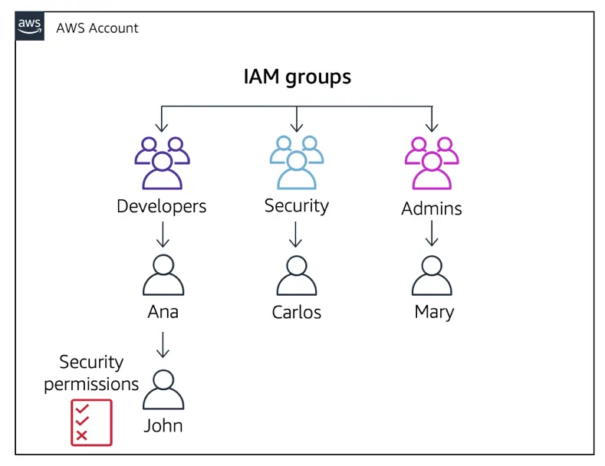
IAM: Groups
A collection of IAM users that are granted identical authorization.
Here are some important characteristics of user groups:
There is no default user group that automatically includes all users in the AWS account. If you want to have a user group like that, you must create it and assign each new user to it.
The number and size of IAM resources in an AWS account, such as the number of groups, and the number of groups that a user can be a member of, are limited.
A user group can contain many users, and a user can belong to multiple user groups.
User groups can't be nested; they can contain only users, not other user groups.

Slide 9
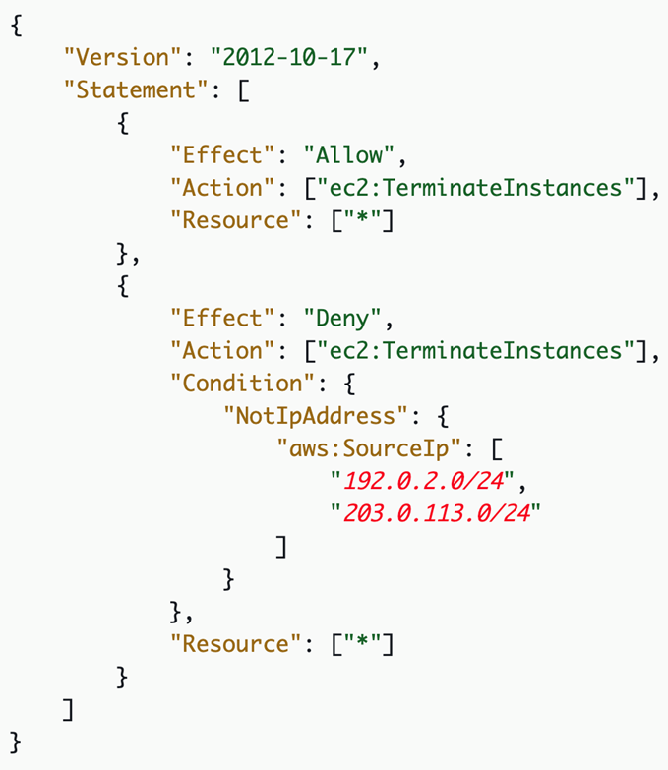
IAM: Policies
Permissions are specified in an IAM policy:
A document formatted in JavaScript Object Notation (JSON)
It defines which resources and operations are allowed
Best practice – follow the principle of least privilege
Two types of policies:
Identity-based: Attach to an IAM principal
Resource-based: Attach to an AWS resource
IAM policy
How IAM determines permissions at the time of request:
Is the permission explicitly denied ?
Is the permission explicitly allowed ?
No
No
Deny
Implicit deny
Yes
Yes
Deny
Allow
Notes:
Does the policy allow you to terminate any EC2 instance at any time without conditions?
ANSWER: No. The first statement object allows it. However, the second statement object applies a condition.
Are you allowed to make the terminate instance call from anywhere?
ANSWER: No. You can only make the request from one of the two IP address ranges that are specified in aws:SourceIp.
Can you terminate instances if you make the call from a server that has an assigned IP address of 192.0.2.243?
ANSWER: Yes, because the 192.0.2.0/24 Classless Inter-Domain Routing (CIDR) IP address range includes IP addresses 192.0.2.0 through 192.0.2.255. A resource like the CIDR to IP Range tool can be used to calculate the range of a CIDR block.

Slide 10
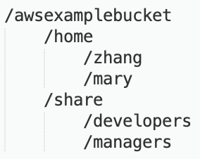
IAM Example for S3
IAM policy grants read, write, list access to /awsexamplebucket/home/zhang
Bucket with home directories for each employee and a share area for groups.
Attached
to
Developer
IAM user
zhang
Member
of
IAM group
IAM policy grants read, write, list access to /awsexamplebucket/share/developers

Slide 11


IAM: Roles
An IAM role is an IAM identity that you can create in your account that has specific permissions.
An IAM role is similar to an IAM user it is uniquely associated with one person
A role is intended to be assumable by anyone who needs it.
Also, a role does not have standard long-term credentials such as a password or access keys associated with it. Instead, when you assume a role, it provides you with temporary security credentials for your role session.
You can delegate access to AWS resources using an IAM role
IAM role
Identity-based policies
Attached to a user, group, or role
Types of policies
AWS managed
Customer managed
Inline
Resource-based policies
Attached to AWS resources
Example: Attach to an Amazon S3 bucket
Always an inline policy
Notes:
Identity-based policies are permission policies that you can attach to a principal (or identity), such as an IAM user, role, or group. These policies control what actions that identity can perform, on which resources, and under what conditions.
Identity-based policies can be further categorized as AWS managed, customer managed, or inline. AWS managed policies are created and managed by AWS, and you can attach them to multiple users, groups, and roles in your AWS account. If you are new to using policies, we recommend that you start by using AWS managed policies. Customer-managed policies are policies that you create and manage in your AWS account. Customer managed policies provide more precise control over your policies than AWS managed policies. You can create and edit an IAM policy in the visual editor or by creating the JSON policy document directly. Inline policies are policies that you create and manage, and that are embedded directly into a single user, group, or role.
Resource-based policies are JSON policy documents that you attach to a resource, such as an Amazon Simple Storage Service (Amazon S3) bucket. These policies control which actions a specified principal can perform on that resource and under what conditions. Resource-based policies are inline policies, and there are no managed resource-based policies.

Slide 12
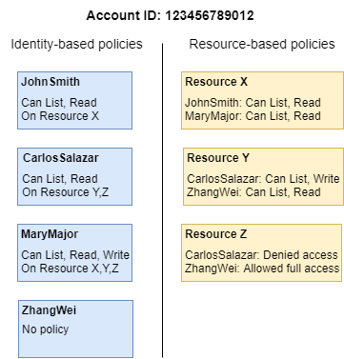
IAM: Roles
JohnSmith – John can perform list and read actions on Resource X. He is granted this permission by the identity-based policy on his user and the resource-based policy on Resource X.
CarlosSalazar – Carlos can perform list, read, and write actions on Resource Y, but is denied access to Resource Z. The identity-based policy on Carlos allows him to perform list and read actions on Resource Y. The Resource Y resource-based policy also allows him write permissions. However, although his identity-based policy allows him access to Resource Z, the Resource Z resource-based policy denies that access. An explicit Deny overrides an Allow and his access to Resource Z is denied. For more information, see Policy evaluation logic.
Notes:
MaryMajor – Mary can perform list, read, and write operations on Resource X, Resource Y, and Resource Z. Her identity-based policy allows her more actions on more resources than the resource-based policies, but none of them deny access.
ZhangWei – Zhang has full access to Resource Z. Zhang has no identity-based policies, but the Resource Z resource-based policy allows him full access to the resource. Zhang can also perform list and read actions on Resource Y.

Slide 13
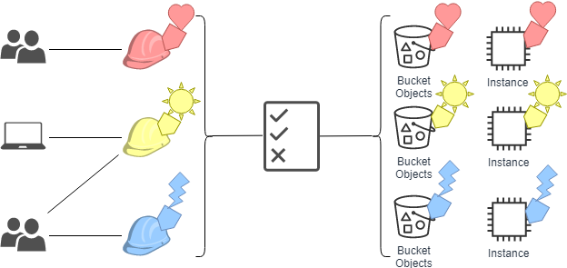
IAM –Access Control -ABAC
Attribute-based access control (ABAC) is an authorization strategy that defines permissions based on attributes.
In AWS, these attributes are called tags.
You can attach tags to IAM resources, including IAM entities (users or roles) and to AWS resources.
You can create a single ABAC policy or small set of policies for your IAM principals.
These ABAC policies can be designed to allow operations when the principal's tag matches the resource tag.
ABAC is helpful in environments that are growing rapidly and helps with situations where policy management becomes cumbersome.
Notes:
For example, you can create three roles with the access-project tag key.
Set the tag value of the first role to Heart, the second to Sun, and the third to Lightning.
You can then use a single policy that allows access when the role and the resource are tagged with the same value for access-project.

Slide 14
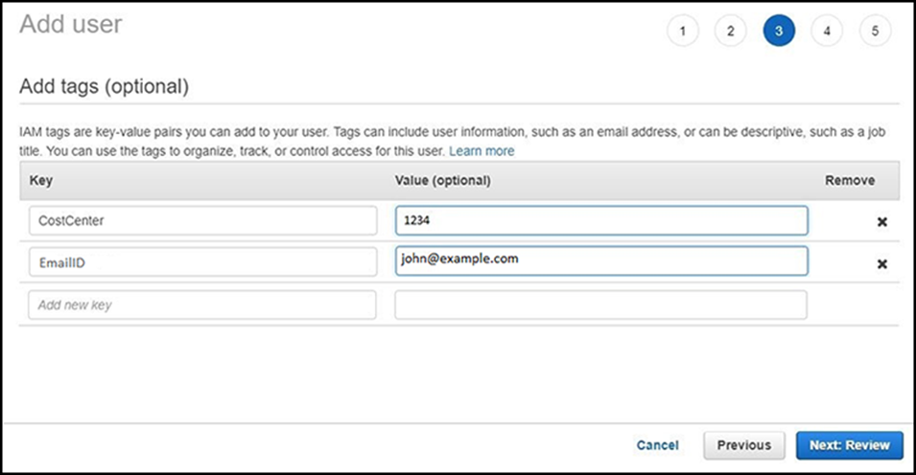
IAM
A tag consists of a name and (optionally) a value
Can be applied to resources across your AWS accounts
Tag keys and values are returned by many different API operations
Define custom tags
Multiple practical uses
Billing, filtered views, access control, etc.
Example tags applied to an EC2 instance:
Name = web server
Project = unicorn
Stack = dev
Tags can also be applied to IAM users or IAM roles
Notes:
AWS enables customers to assign metadata to their AWS resources and identities in the form of tags. Each tag is a simple label that consists of a customer-defined key and an optional value. Tags can make it easier to manage, search for, and filter resources.
Tags have many practical uses. For example, you can create technical tags to identify that a resource is a web server, part of a specific project, part of a specific environment (test, development, or production), among others. You can also create business tags to identify the department or cost center that should be billed for this resource or the project that this resource is a part of. Finally, you can also set security tags, such as an identifier for the specific data-confidentiality level that a resource supports.
You can create up to tags per resource. For each resource, each tag key must be unique, and each tag key can have only one value. Tag keys and values are case-sensitive.
You can also add tags to IAM users and IAM roles. Tags are an important part of the second access-control method that you will learn about next.

Slide 15
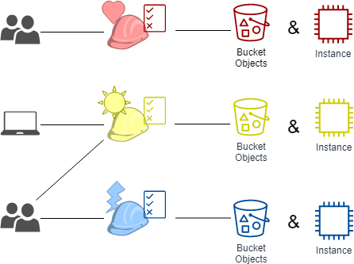
IAM –Access Control -RBAC
The traditional authorization model used in IAM is called role-based access control (RBAC).
RBAC defines permissions based on a person's job function, known outside of AWS as a role.
Within AWS a role usually refers to an IAM role, which is an identity in IAM that you can assume.
IAM does include managed policies for job functions that align permissions to a job function in an RBAC model
In IAM, you implement RBAC by creating different policies for different job functions.
You then attach the policies to identities (IAM users, groups of users, or IAM roles).
As a best practice, you grant the minimum permissions necessary for the job function. This is known as granting least privilege. Do this by listing the specific resources that the job function can access.
The disadvantage to using the traditional RBAC model is that when employees add new resources, you must update policies to allow access to those resources.
Notes:
RBAC has been used historically on-premises and in the cloud. With this model, you grant users explicit access to a set of permissions. Say that you have database administrators, network administrators, and developers. If you have one or more network administrators who are also developers, you would not create a new policy to grant those permissions. Instead, you add those users to both roles.
This approach is familiar and has many advantages. However, the person who maintains the permissions in this model might find that they must constantly update the permissions files to add access to certain roles each time a new resource is created. For example, they must update a policy with an ARN each time someone creates a new resource and wants to allow users access to it.

Slide 16
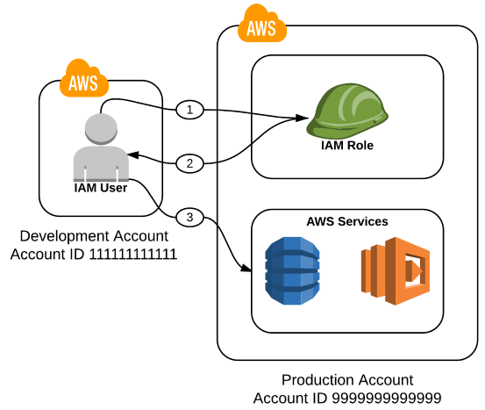
IAM: Switching Roles
You can grant a user permission to switch to a role by creating a new policy and attaching it to the user
AssumeRole,
AssumeRoleWithSAML and
AssumeRoleWithWebIdentity
You define these permissions when you create or update the role
In this workflow:
An IAM user connects to the AWS Security Token Service (AWS STS) and assumes a role in the Production account.
AWS STS returns a set of temporary credentials.
The IAM user uses the set of temporary credentials to access resources and services in the production account

Slide 17
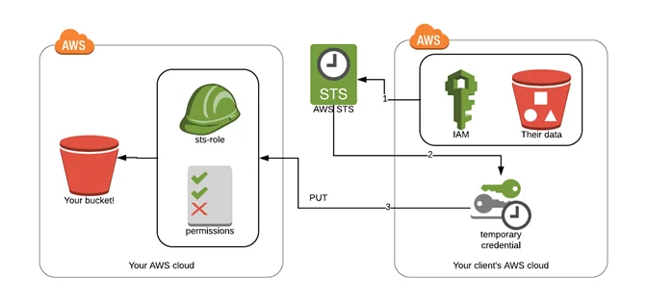
AWS : Security Token Services (STS)
AWS provides AWS Security Token Service (AWS STS) as a web service that enables you to request temporary, limited-privilege credentials for AWS Identity and Access Management (IAM) users or for users you authenticate (federated users)
Temporary security credentials are short-term. They can be configured to last for anywhere from a few minutes to several hours. After the credentials expire, AWS no longer recognizes them or allows any kind of access from API requests made with them.
Temporary security credentials are not stored with the user but are generated dynamically and provided to the user when requested. When (or even before) the temporary security credentials expire, the user can request new credentials, as long as the user requesting them still has permissions to do so.
Steps:
Your client uses their IAM user to call AWS STS and requests the role ARN you gave them
STS authenticates the client’s IAM user and verifies the policy for the ARN role, then issues a temporary credential to the client.
The client can use the temporary credentials to access your S3 bucket (they will expire soon

Slide 18




AWS Identity Federations : External Users
Identity federation*
User authentication completed by a system that is external to the AWS account
Example: corporate directory
It provides a way to allow access through existing identities, without creating IAM users
Identity federation options
AWS STS
Public identity service providers (IdPs)
Custom identity broker application
Security Assertion Markup Language (SAML)
Amazon Cognito
IdP authentication overview
User accesses
identity broker
via application
Identity broker
authenticates
user
Requests temporary
credentials
from AWS STS
Temporary credentials
returned to application

Slide 19
What is Identity Federation ?
Identity federation is a system of trust between two parties for the purpose of authenticating users and conveying information needed to authorize their access to resources.
In this system,
an identity provider (IdP) is responsible for user authentication,
and a service provider (SP), such as a service or an application, controls access to resources.

Slide 20







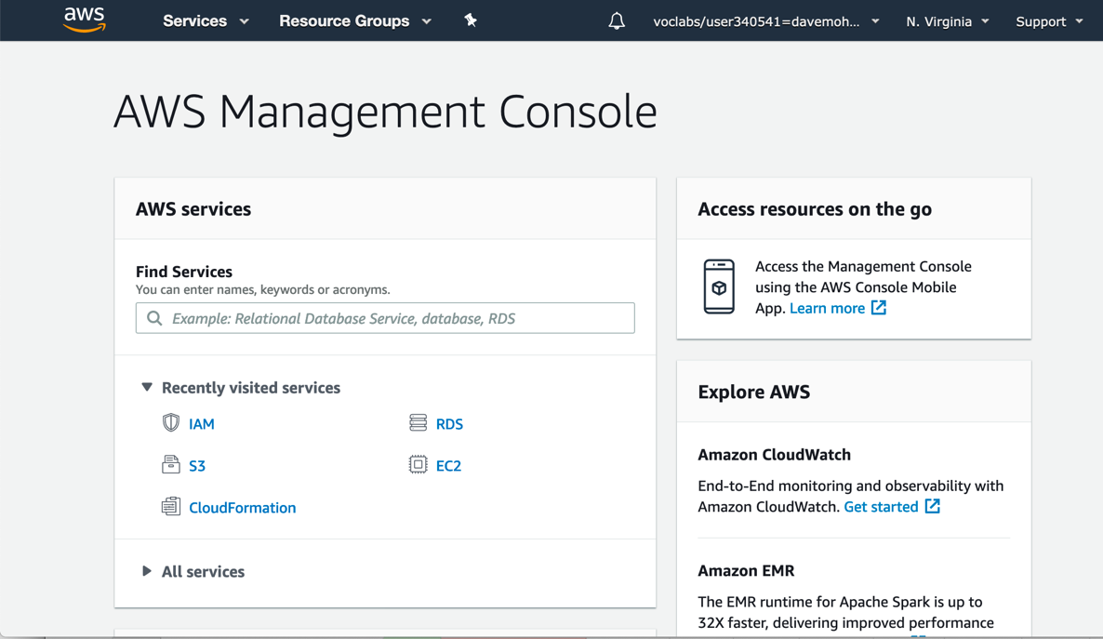



Identity Federation with an Identity Broker
Customer
AWS Cloud
Application
User accesses broker
AWS services
1
4
User accesses AWS services or console
Single sign-on (SSO)
Broker retrieves temporary security credentials from STS, passes them to user application
2
User authenticated
3
IAM
AWS STS
Corporate identity store
Identity broker
Role
Policy
Notes:
The process includes these steps:
A user accesses an application. The user enters their user ID and password, and submits them
The identity broker receives the authentication request. It then communicates with the corporate identity store, which might be Microsoft Active Directory or a Lightweight Directory Access Protocol (LDAP) server.
If the authentication request is successful, the identity broker makes a request to AWS STS. The request is to retrieve temporary AWS security credentials for the user application.
The user application receives the temporary AWS security credentials and redirects the user to the AWS Management Console. The user did not need to sign directly in to AWS with a different set of credentials. This process is an example of a single-sign on (SSO) implementation. The user application could also use these same temporary AWS security credentials to access AWS services if the IAM policy document allows it.

Slide 21


Identity Federation using SAML
Customer
Assertion posted to sign in endpoint for SAML
AWS Cloud
IAM
User navigates to a URL
4
Role
1
Sign-in endpoint for SAML
AWS STS
Policy
Redirected to the console
3
5
IdP returns SAML assertion
2
IdP authenticates user
Identity store (LDAP or Microsoft Active Directory)
Portal (IdP)
Notes:
The process involves these steps:
A user in your organization navigates to an internal portal in your network. The portal also functions as the IdP that handles the SAML trust between your organization and AWS.
The IdP authenticates the user’s identity against the identity store, which might be an LDAP server or Microsoft Active Directory.
The portal receives the authentication response as a SAML assertion from the IdP.
The client posts the SAML assertion to the AWS sign-in endpoint for SAML. The endpoint communicates with AWS STS, and it invokes the AssumeRoleWithSAML operation to request temporary security credentials and construct a sign-in URL.
The client receives the temporary AWS security credentials. The client is redirected to the AWS Management Console and is authenticated with the temporary AWS security credentials.

Slide 22
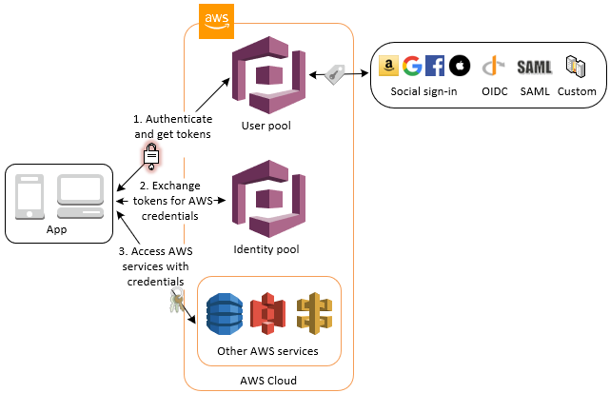
Amazon Cognito
Amazon Cognito provides authentication, authorization, and user management for your web and mobile apps. Your users can sign in directly with a user name and password, or through a third party such as Facebook, Amazon, Google or Apple.
The two main components of Amazon Cognito are user pools and identity pools. User pools are user directories that provide sign-up and sign-in options for your app users. Identity pools enable you to grant your users access to other AWS services. You can use identity pools and user pools separately or together.
An Amazon Cognito user pool and identity pool used together
User pools : A user pool is a user directory in Amazon Cognito.
Identity pools : Users can obtain temporary AWS credentials to access AWS services
Identity pools support anonymous guest users

Slide 23
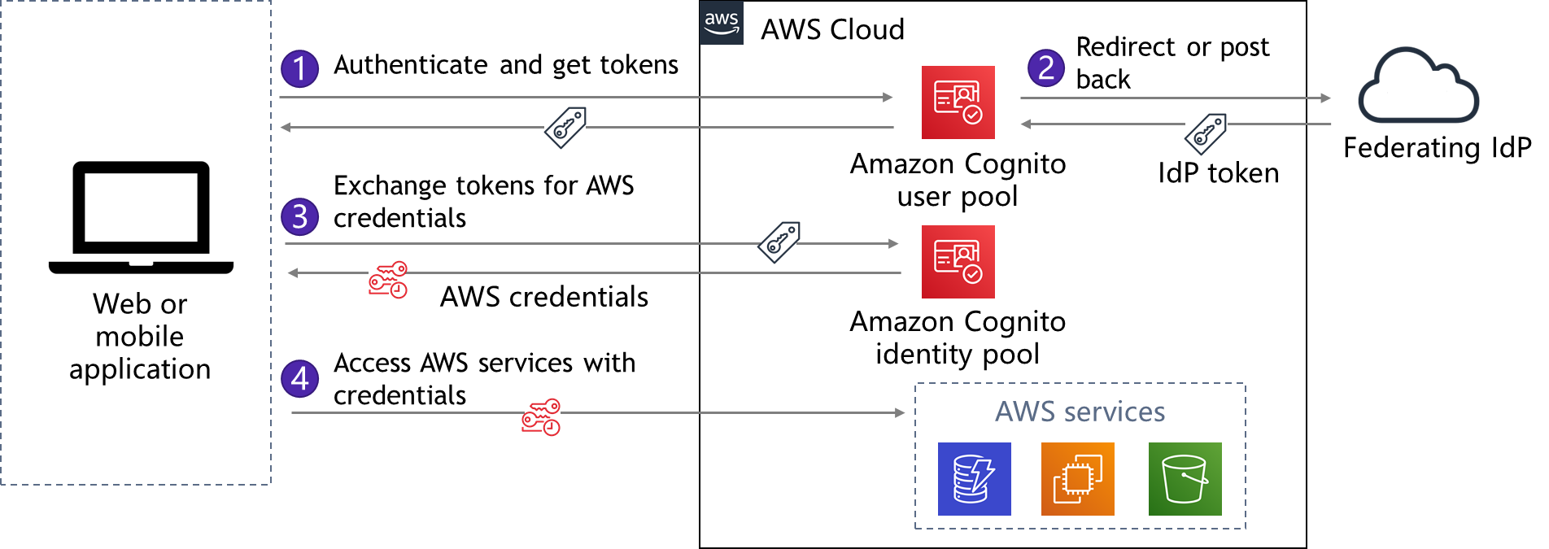
Amazon Cognito Example
In this scenario, the goal is to authenticate a user using Amazon Cognito, and then grant that user access to another AWS service.
Notes:
Steps
In the first step, the app user signs in through an Amazon Cognito user pool and, after successfully authenticating, receives user pool tokens.
Next, the app exchanges the user pool tokens for AWS credentials through an Amazon Cognito identity pool.
Finally, the app user uses those AWS credentials to access other AWS services.

Slide 24


Amazon Cognito example
AWS Cloud
Authenticate and get tokens
Redirect or post back
1
2
Amazon Cognito user pool
Federating IdP
Exchange tokens for AWS credentials
IdP token
3
Web or mobile application
AWS credentials
Amazon Cognito identity pool
Access AWS services with credentials
4
AWS services
Notes:
In this scenario, the goal is to authenticate a user using Amazon Cognito, and then grant that user access to another AWS service.
In the first step, the app user signs in through an Amazon Cognito user pool and, after successfully authenticating, receives user pool tokens.
Next, the app exchanges the user pool tokens for AWS credentials through an Amazon Cognito identity pool.
Finally, the app user uses those AWS credentials to access other AWS services.

Slide 25

IAM : Single vs Multiple Accounts
Two architectural patterns
Most organizations choose to create multiple accounts
Advantages/Disadvantages of multiple accounts
Isolate business units or departments
Isolate development, test, and production environments
Isolate auditing data, recovery data
Separate accounts for regulated workloads
Easier to trigger cost alerts for each business unit's consumption
Security management across accounts (IAM policy replication )
Creating new accounts
Billing consolidation
Centralized governance is needed to ensure consistency
Multiple VPCs in a single account architectural pattern
AWS account
VPC
VPC
VPC
VPC
Shared services
Development
Test
Production
Multiple accounts, a VPC in each account architectural pattern
AWS account
AWS account
AWS account
AWS account
VPC
VPC
VPC
VPC
Shared services
Development
Test
Production

Slide 26
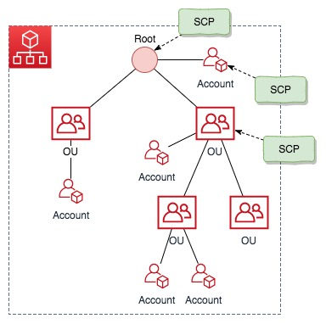
Manage multiple accounts with AWS Organizations
AWS Organizations helps you centrally manage and govern your environment as you grow and scale your AWS resources. Using AWS Organizations, you can programmatically create new AWS accounts and allocate resources, group accounts to organize your workflows, apply policies to accounts or groups for governance
Simplify billing by using a single payment method for all of your accounts.
AWS Organizations is integrated with other AWS services so you can define central configurations, security mechanisms, audit requirements, and resource sharing across accounts in your organization.
AWS Organizations is available to all AWS customers at no additional charge
SCP : Service Control Policies
Notes:
AWS offers a service that is designed to address these management challenges.
AWS Organizations is a managed service for account management. An organization is an entity that you create to consolidate, centrally view, and manage all your AWS accounts. You determine the functionality of an organization through the feature set that you enable.
Organizations helps you manage policies for multiple AWS accounts. You can use the service to create groups of accounts. You can then attach policies to a group so that the correct policies are applied across the accounts.
You can create groups of AWS accounts, and then apply different policies to each group.
The Organizations APIs can create new accounts programmatically and add them to a group. The policies that are attached to the group are automatically applied to the new account.
You can also set up a single payment method for all the AWS accounts in your organization through consolidated billing. With consolidated billing, you can see a combined view of charges that are incurred by all your accounts.
Finally, you can manage the use of AWS services at the API level. For example, you can apply a policy to a group of accounts that will only allow IAM users in those accounts to read data from S3 buckets.

Slide 27





AWS Organization Example
Which accounts does each SCP apply to?
In the AWS Organizations master account:
Create a hierarchy of organizational units (OUs)
Assign accounts to OUs as member accounts
Define service control policies (SCPs) that apply permissions restrictions to specific member accounts
Attach the SPCs to root, OUs, or accounts
AWS Cloud
Master account
Member accounts
AWS Organizations
AWS account
A
Internal IT OU
Account 1
root
AWS account
A
A
Engineering OU
Account 2
SCP Policy A
AWS account
A
B
Development OU
Account 3
B
SCP Policy B
AWS account
A
Production OU
Account4
C
AWS account
A
C
SCP Policy C
Account 5
Notes:
Here is an example AWS organization. It is defined inside a regular AWS account that is called the master account because the AWS organization is defined in it.
When you create an organization in the master account, the organization automatically creates a parent container that is called root. Under each root in the organization, you can then define organizational units, which are also known as OUs. Each OU is a container for member accounts. An OU can also contain other OUs, and those OUs can contain more accounts. This feature enables you to create a tree-like hierarchy. You can think of the root and OUs as branches that reach out and end in accounts, which are like the leaves of the tree.
To configure access controls across accounts, you then define service control policies (SCPs). Attach each policy to the appropriate place in the hierarchy of OUs and accounts. The policy flows out away from the root and it affects all OUs and accounts beneath it. Therefore, if you apply an SCP to the root (like SCP Policy A in the example), it will apply to all OUs and accounts in the organization. You can attach an SCP to the root, to any OU, or to an individual account.
Remember that like IAM policies, SCPs will only grant access if it is both explicitly allowed and is not explicitly denied by any other SCP or IAM policy that applies to the user. For example, say that SCP Policy A, which is applied to the root of the organization, sets more restrictions on a particular service or set of resources than SCP Policy C. Then, users in Account 5 are subject to the more restrictive permissions set by Policy A. Similarly, if any IAM policies at the individual account level explicitly deny any actions for the user, these IAM policies override any permissions in the SCPs that are granted to the account.

Slide 28
AWS Organization :SCPs
Characteristics of service control policies (SCPs)
They enable you to control which services are accessible to IAM users in member accounts
SCPs cannot be overridden by the local administrator
IAM policies that are defined in individual accounts still apply
Example uses of SCPs
Create a policy that blocks service access or specific actions
Example: Deny users from disabling AWS CloudTrail in all member accounts
Create a policy that allows full access to specific services
Example: Allow full access to Amazon EC2 and CloudWatch
Create a policy that enforces the tagging of resources
Notes:
Service control policies (SCPs) enable you to control which services are accessible to IAM users in member accounts. Say that you have specific policies that you want to apply across multiple accounts. It is easier to define these policies in an SCP than to replicate these permissions settings into IAM policy documents in each account.
SCPs should be used with IAM policies that are defined in each individual account. You can think of the SCPs as providing general boundaries around the services and general permissions that users should be allowed or denied access to. Then, you can use IAM policies to set more granular access controls that are specific to individual accounts.
You can author SCPs that block (or deny) access to certain services. You can also define SCPs that allow access to certain services. Finally, you might decide to create an SCP that enforces the tagging of resources. By doing so, your tagging strategy for access control or cost allocation can remain effective when new resources are created in your accounts.

Slide 29
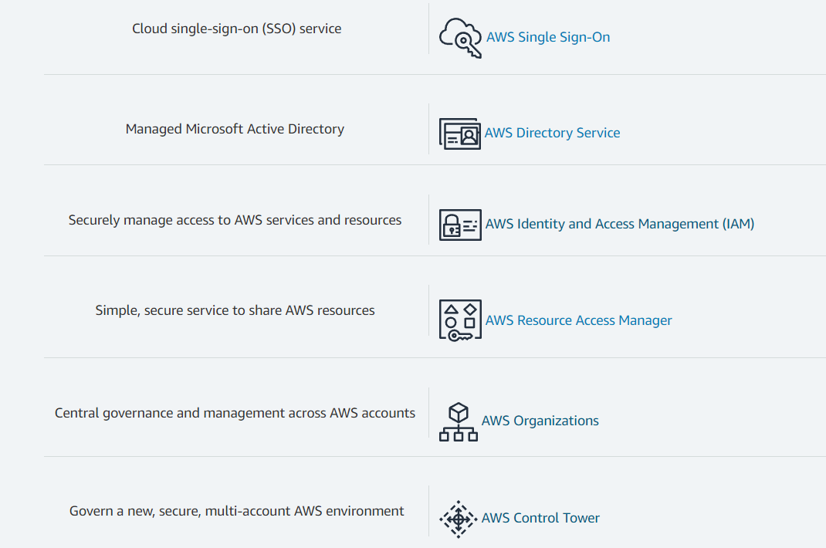
Other AWS Identity Services

Slide 30
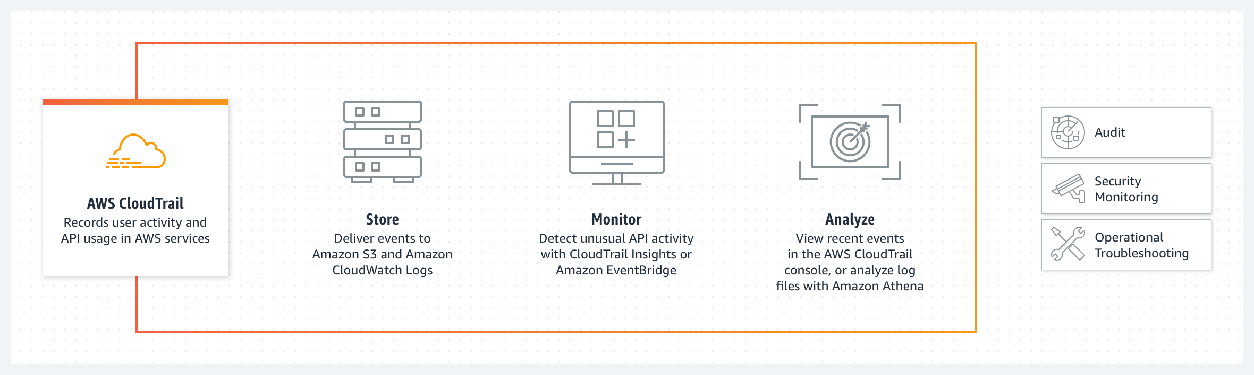
AWS CloudTrail
AWS CloudTrail enables auditing, security monitoring, and operational troubleshooting by tracking user activity and API usage.
CloudTrail logs, continuously monitors, and retains account activity related to actions across your AWS infrastructure, giving you control over storage, analysis, and remediation actions.
Notes:
AWS CloudTrail is a service that enables governance, compliance, and auditing of your AWS account. With CloudTrail, you can continuously monitor and retain account activity that is related to actions across your AWS infrastructure. It provides an event history of account activity, including actions taken through the AWS Management Console, AWS SDKs, and command line tools. This event history simplifies security analysis, resource change tracking, and troubleshooting.
You can discover and troubleshoot security and operational issues by capturing a comprehensive history of changes that occurred in your AWS account within a specified period of time. You can identify which users and accounts called AWS, the source IP address that the calls were made from, and when the calls occurred. CloudTrail enables you to track and automatically respond to account activity that threatens the security of your AWS resources.
With Amazon EventBridge (formerly known as Amazon CloudWatch Events) integration, you can define workflows that execute when it detects events that can result in security vulnerabilities. For example, you can create a workflow to add a specific policy to an S3 bucket when CloudTrail logs an API call that makes that bucket public.
CloudTrail records important information about each action, including who made the request, the services used, the actions performed, parameters for the actions, and the response elements that were returned by the AWS service. The service also helps organizations meet the compliance and auditing requirements that they must adhere to.

Slide 31
AWS CloudTrail
AWS CloudTrail enables auditing, security monitoring, and operational troubleshooting by tracking user activity and API usage.
CloudTrail logs, continuously monitors, and retains account activity related to actions across your AWS infrastructure, giving you control over storage, analysis, and remediation actions.
Notes:
AWS CloudTrail is a service that enables governance, compliance, and auditing of your AWS account. With CloudTrail, you can continuously monitor and retain account activity that is related to actions across your AWS infrastructure. It provides an event history of account activity, including actions taken through the AWS Management Console, AWS SDKs, and command line tools. This event history simplifies security analysis, resource change tracking, and troubleshooting.
You can discover and troubleshoot security and operational issues by capturing a comprehensive history of changes that occurred in your AWS account within a specified period of time. You can identify which users and accounts called AWS, the source IP address that the calls were made from, and when the calls occurred. CloudTrail enables you to track and automatically respond to account activity that threatens the security of your AWS resources.
With Amazon EventBridge (formerly known as Amazon CloudWatch Events) integration, you can define workflows that execute when it detects events that can result in security vulnerabilities. For example, you can create a workflow to add a specific policy to an S3 bucket when CloudTrail logs an API call that makes that bucket public.
CloudTrail records important information about each action, including who made the request, the services used, the actions performed, parameters for the actions, and the response elements that were returned by the AWS service. The service also helps organizations meet the compliance and auditing requirements that they must adhere to.

Slide 32
AWS CloudTrail
Logs and monitors user activity
Provides event history of AWS account
Actions taken through the AWS Management Console, SDKs, AWS CLI
Increases visibility into your user and resource activity
90-day event history provided by default, at no cost /per Region
Identify
Who accessed your account
When and from where
What action they took on an AWS service
Helpful tool to
Perform security analysis
Discover which calls were blocked (for example, by IAM policies)

Slide 33
Questions ?

